Slide 1
Geological Map Sem -1

Slide 2
Bedding Plane
A bedding plane is defined as a surface representing a contact between a deposit and the depositing medium during a time of change. They are primary features of sedimentary rocks formed usually by the depositing media water, and atmosphere.

Slide 3
Bed
In geology, a bed is a layer of sediment, sedimentary rock, or pyroclastic material "bounded above and below by more or less well-defined bedding surfaces".

Slide 4
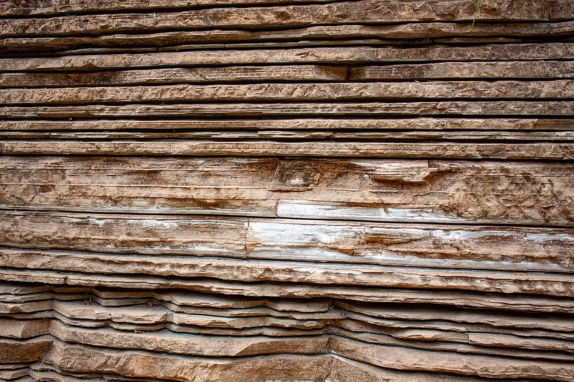

Slide 5
Dip
Dip is the angle at which a planar feature is inclined to the horizontal plane; it is measured in a vertical plane perpendicular to the strike of the feature.

Slide 6
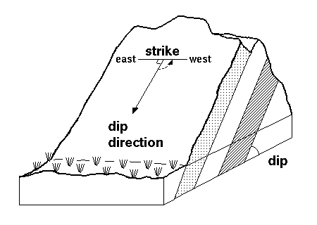

Slide 7
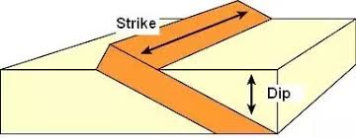

Slide 8
Strike Line
Strike refers to the line formed by the intersection of a horizontal plane and an inclined surface. This line is called a strike line, and the direction the line points in (either direction, as a line points in two opposite directions) is the strike angle.

Slide 9
Fault
In geology, a fault is a planar fracture or discontinuity in a volume of rock across which there has been significant displacement as a result of rock-mass movements. Large faults within Earth's crust result from the action of plate tectonic forces, with the largest forming the boundaries between the plates

Slide 10
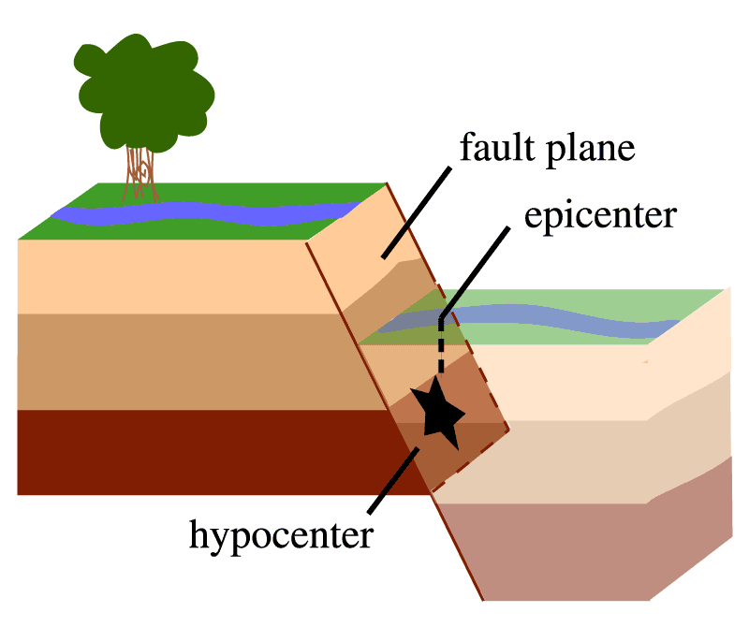

Slide 12
Thank you

